Slide 1
Capstone Project
Machine Learning Fundamentals
Long Vo [11-12-2018]

Slide 2
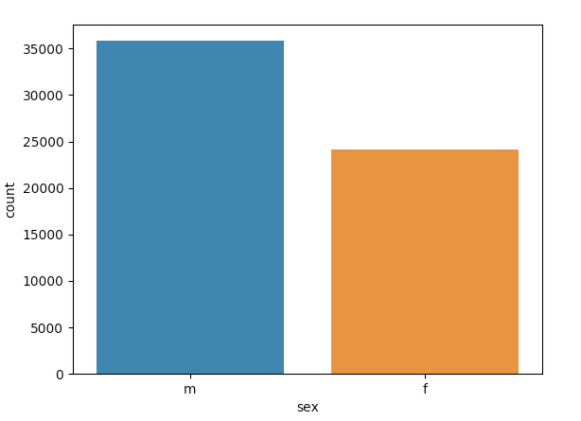
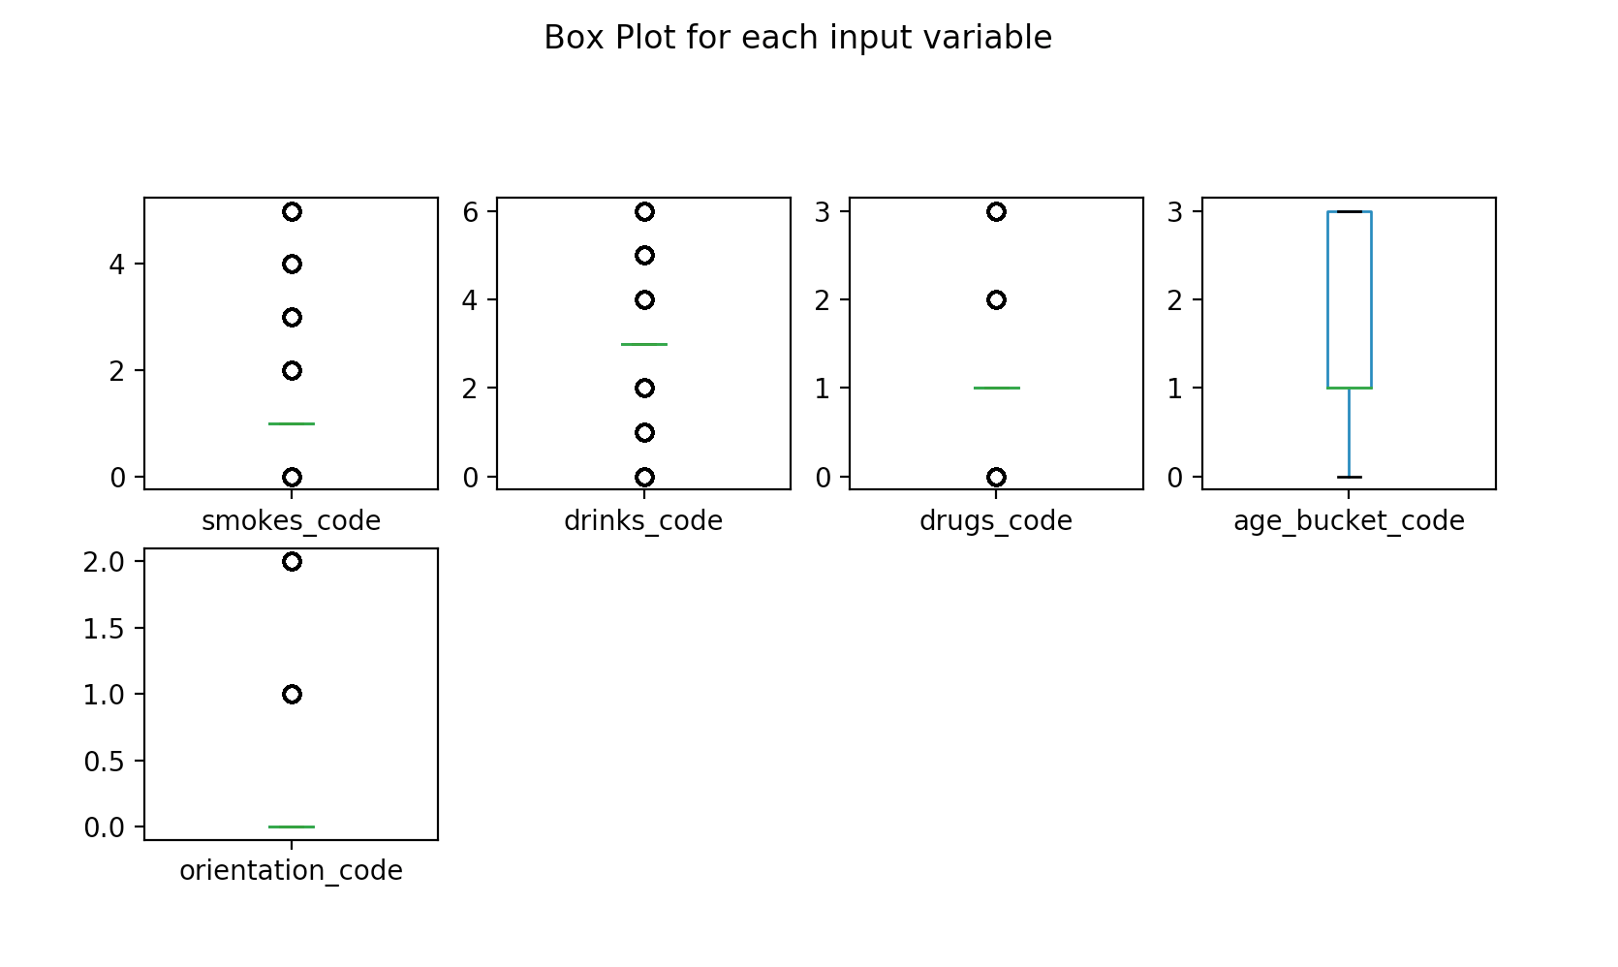
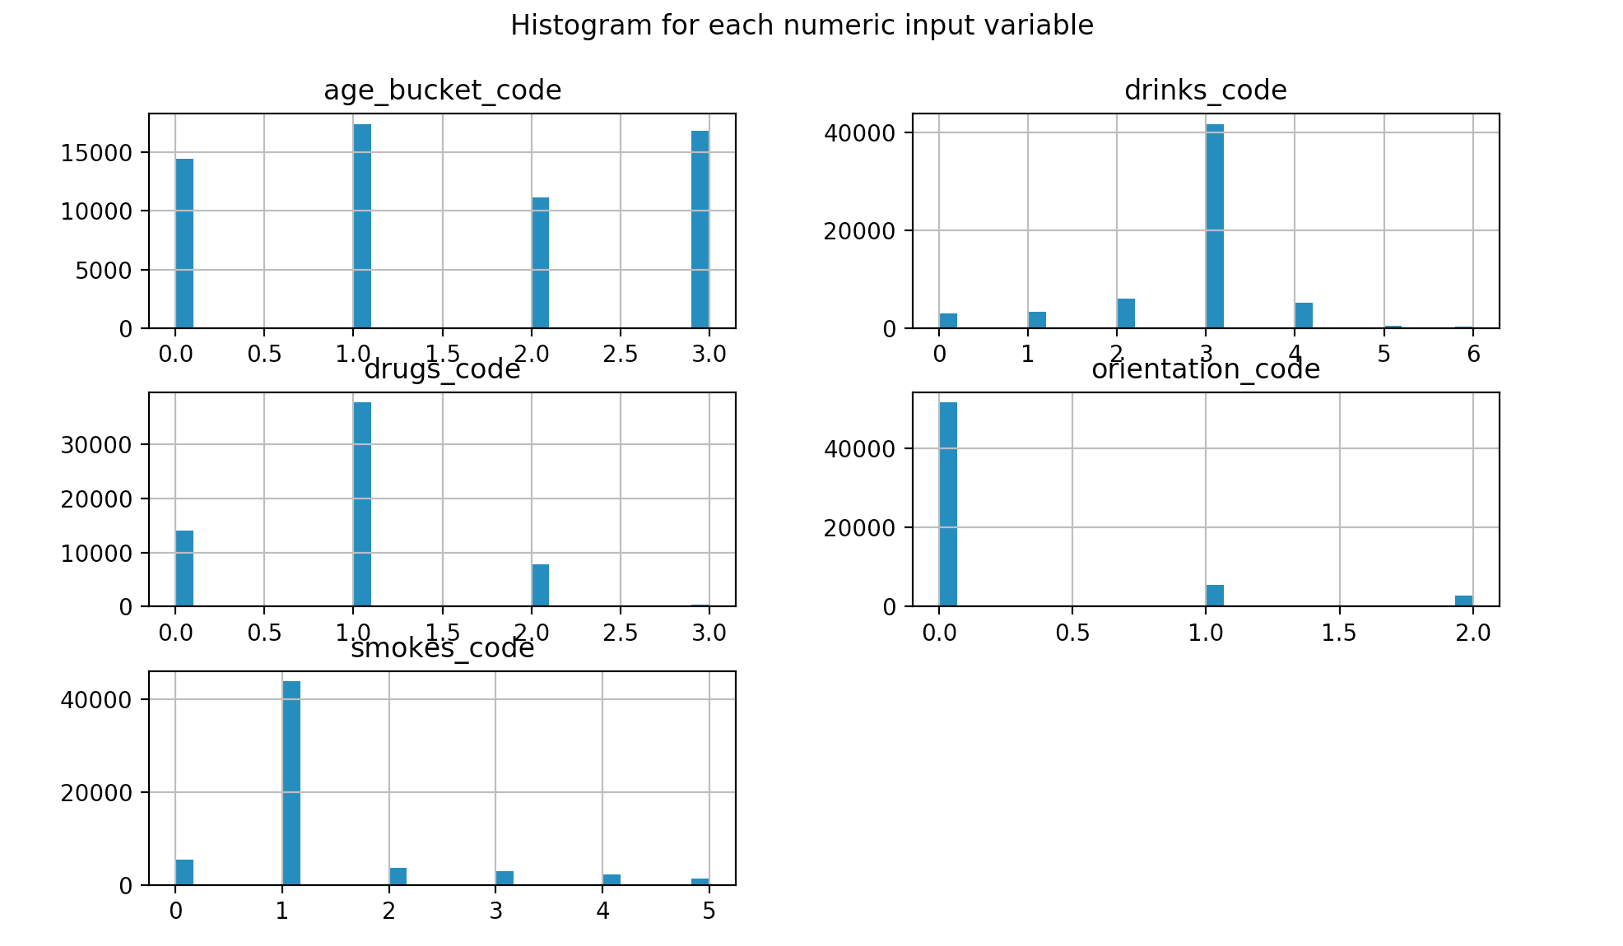
The Data exploration

Slide 3
Can we predict the gender from age buckets, orientation, drug usage, alcohol usage, and cigarette usage?
With quite a bit of data points, I initially thought we should be easily be able to predict the gender of a user based on the above inputs.

Slide 4
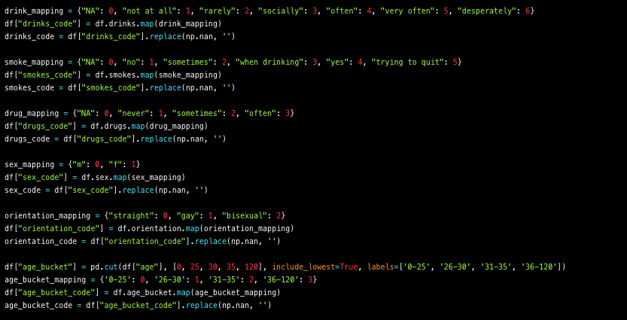
New Columns created and added to the dataframe
With much of the data categorical, I created multiple columns with numerical mappings for smokes, drinks, sex, orientation.
I didn’t want as many ages so I created an age bucket column for labels and a numerical column as well.

Slide 5
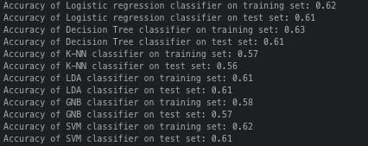

The Results

Slide 6
Conclusion
Linear Regression model yielded low scores and was not useful. The data was mainly categorical which didn’t make much sense to use the linear regression method.
My scores for the various classification models used did not yield anything with much confidence. My models were able to predict if the gender was Male more accurately than Female. I think this may be because the data had more Men’s records.
With more time I am looking to improve these scores by either adding or removing inputs, using better normalization and looking at the data in depth overall.

